Slide 1
E-cap Reliability
Overview and preliminary results

Slide 2
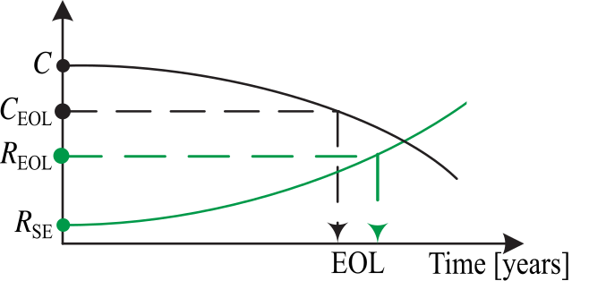
Overview
Context
Capacitors are one of the main concerns in inverter reliability
Health indicators (capacitance and series resistance) can’t be measured online or without additional hardware
Machine learning (ML) can be used to estimate the indicators using other measurements
AQUI FOTO DE INVERSOR E CAPACITORES

Slide 3
Overview
Objective
Develop noninvasive, inverter-embedded methods for monitoring capacitor degradation and estimating remaining useful life.
Market value
Cost reduction opportunities: the reliability estimation can provide insights on the behavior and impact of the capacitor aging during operation:
  Know-how to improve design/spec
  Field evaluation/maintenance
Predictive maintenance (new inverter feature): estimating the remaining useful life of the capacitor can be used to avoid catastrophic failure of the inverter due to capacitor degradation.

Slide 4
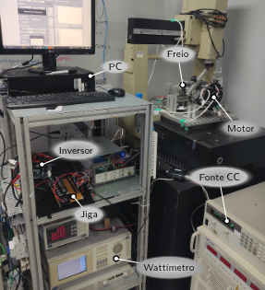
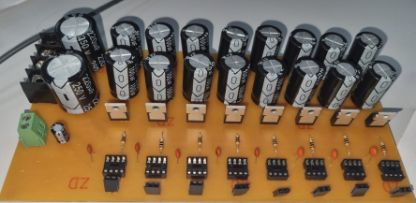
Project timeline - past activities
Team:
LIAE: 1 PhD student
1 undergraduate
Nidec: 1 senior researcher
Developed ML models for estimating capacitance based on directly measurable quantities
Developed a variable-capacitance test jig
Modified inverter to connect to the jig
03/2025
08/2025
ML validation
Review & planning
Capacitor jig prototype
Experimental tests
10/2025
05/2025
Embedded measurement evaluation
Capacitance and series resistance are the main indicators of degradation
Statistical features and frequency spectrum of DC-link voltage can be used to estimate the indicators
ML models are useful for estimation, but require large amounts of data
Connected the inverter to a compressor motor + brake to control load
Ran tests at different speeds and loads
Evaluated the embedded DAQ for DC-link voltage measurement
Compared against a high-precision voltmeter

Slide 5
Research questions
Capacitance degradation monitoring
Accelerated degradation tests
(electrical and thermal stress)
Emulated degradation via capacitance
(variable capacitance jig)
Emulated degradation via ESR
(variable ESR jig)
RQ1: Which electrical parameters are sensitive to degradation
Capacitance?
Equivalent series resistance?
Both?
RQ4: Can changes in capacitance be estimated during inverter operation?
Develop estimation methods
Use inverter electrical measurements
RQ7: Is ESR a relevant degradation indicator?
If not, proceed only with capacitance
RQ8: Can ESR variance be reliably emulated and measured with current hardware and tests?
If yes, then evaluate questions RQ4, RQ5 and RQ6 for ESR instead of capacitance
If no, redesign experiments and instrumentation.
RQ5: How reliable is the estimation across operating conditions?
Estimation error vs. capacitance
Different operating conditions
Hardware requirements
RQ2: How do the indicators evolve with degradation time?
Degradation rate
Degradation stage
RQ3: How does the behavior vary across samples and specifications?
Same indicators?
Similar trends?
RQ6: Can the tests be performed in simulations?
Compare experimental results and simulated models
Simulate for different grid parameters
Outcome: validated method for monitoring capacitor degradation during inverter operation and guidelines for feature tests

Slide 6
Accelerated testing: methods
Based on recent research we proceeding mainly two methods to quickly degrade the capacitor:
  Thermal stress - using an industrial oven, we apply about 130 ⁰C of temperature at cycles of approximately 48 hours. At end of each cycle we turn of the oven, decrease the temperature naturally, leave the specimens in a temperature controlled room and perform the measurements of C and ESR. Then we put the specimens back to oven and gradually increase the temperature.
    Obs: we are not applying voltage in this tests; five capacitors are under tests.

Slide 7
Accelerated testing: methods
  Electrical stress - using a half bridge rectifier, we apply a semi-senoidal voltage of about 170 V (confirmar) and a ripple current of approximately 3,7A (confirmar). The specimen under test rested in a room with controlled temperature. Measurements of C and ESR are performed at intervals of approximately 48 hours.
    Obs: we are not applying temperature changes in this tests, just one capacitor is under test

Slide 8
Accelerated testing: preliminary results (thermal)
Measurements of C and ESR are performed at 100 Hz, 120 Hz and 1 kHz using the xxx portable RLC and the yyy workbench RLC.
Five measurements of each parameter are performed for each frequency.
At present time (after more than 3000 hours of esaie) we can observe that the Capacitance doesn't presented any considerable reduction and ESR presented an significant increase. This is shown in the following graphics.
Note: only measurements did with workbench instrument are presented (we consider it more accurately).

Slide 9
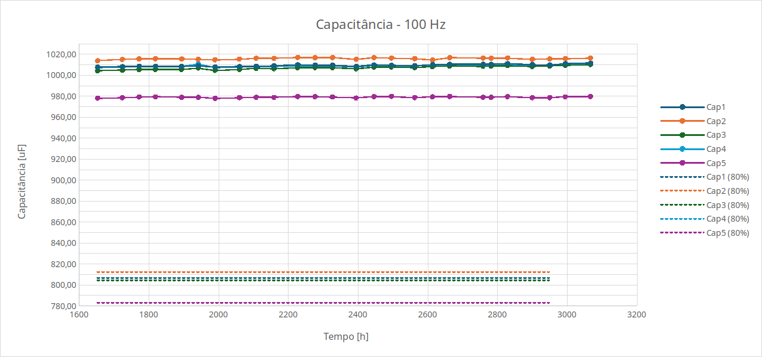
Accelerated testing: preliminary results (thermal)

Slide 10
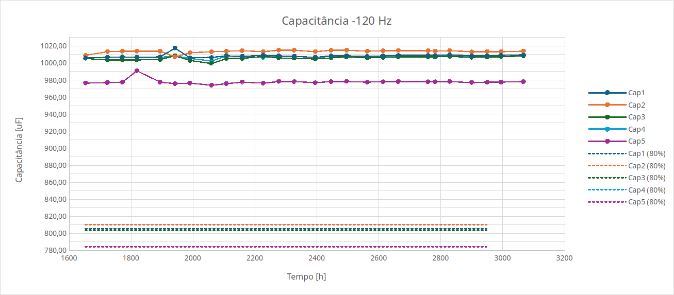
Accelerated testing: preliminary results (thermal)

Slide 11
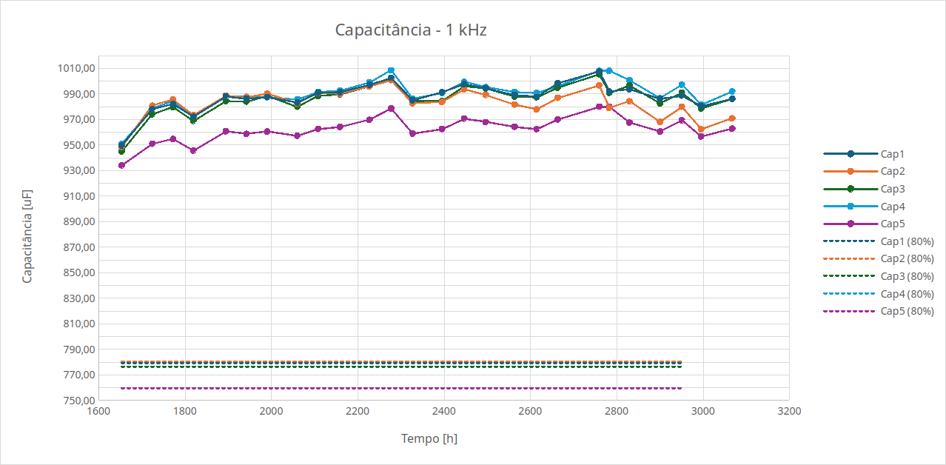
Accelerated testing: preliminary results (thermal)

Slide 12
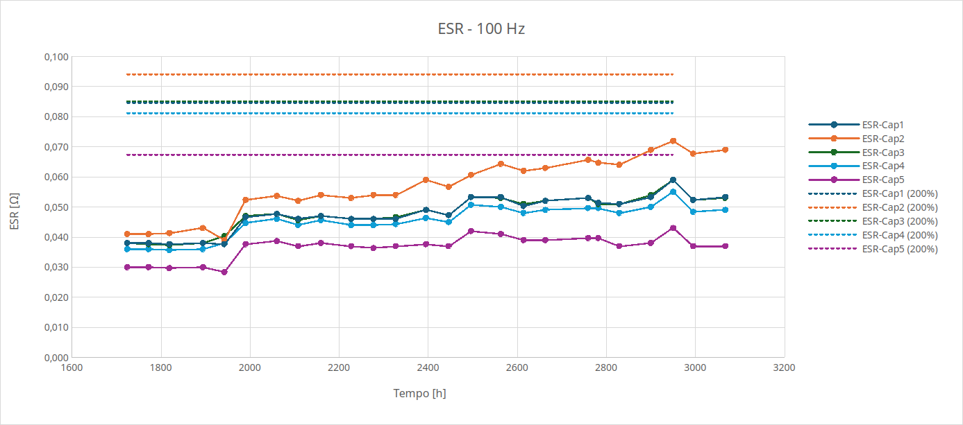
Accelerated testing: preliminary results (thermal)

Slide 13
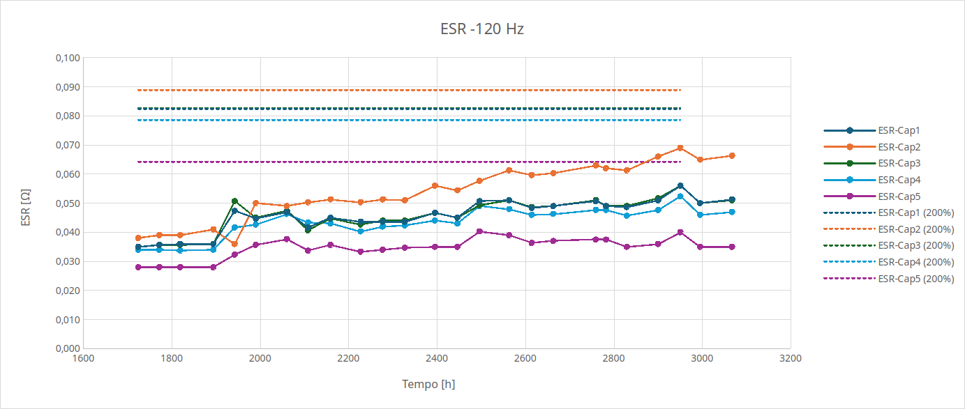
Accelerated testing: preliminary results (thermal)

Slide 14
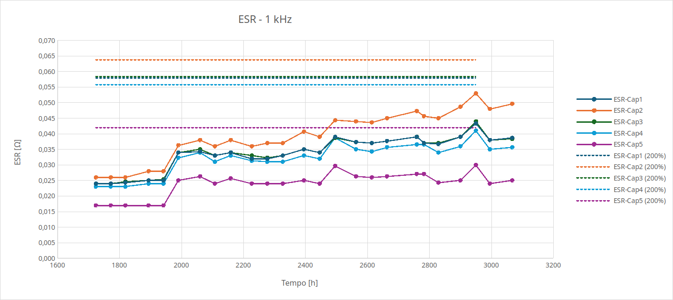
Accelerated testing: preliminary results (thermal)

Slide 15
Accelerated testing: preliminary results (electrical)
Measurements of C and ESR are performed at 100 Hz, 120 Hz, 1 Kz and 10 kHz using the yyy workbench RLC.
Five measurements of each parameter are performed for each frequency.
At present time (after more than 1000 hours of esaie) we can observe that neither Capacitance nor ESR presented any considerable reduction. This is shown in the following graphics.
Note: only measurements did with workbench instrument are presented.

Slide 16
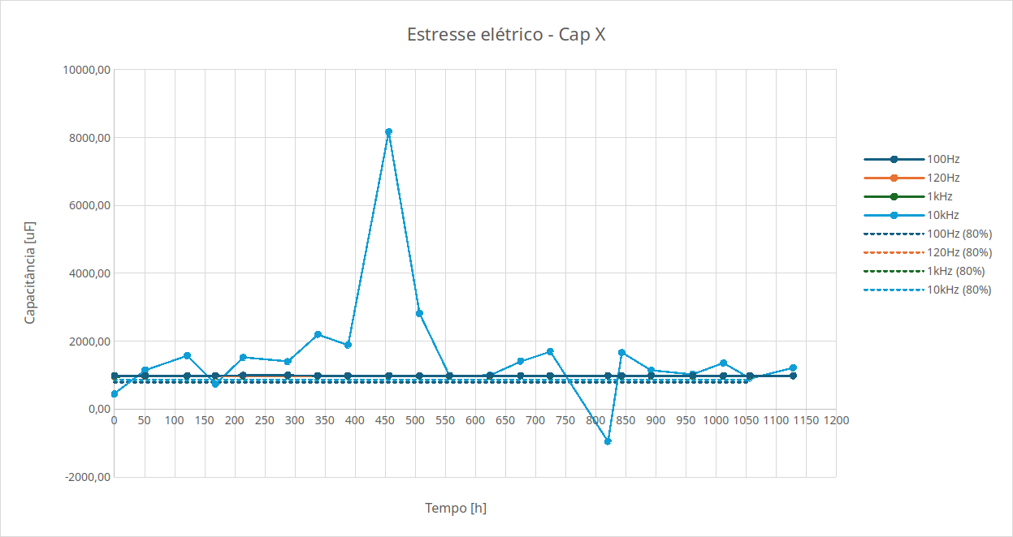
Accelerated testing: preliminary results (electrical)

Slide 17
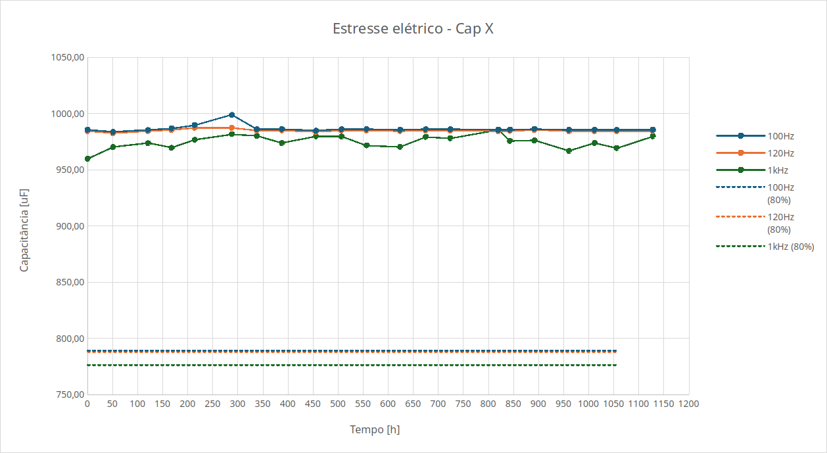
Accelerated testing: preliminary results (electrical)

Slide 18
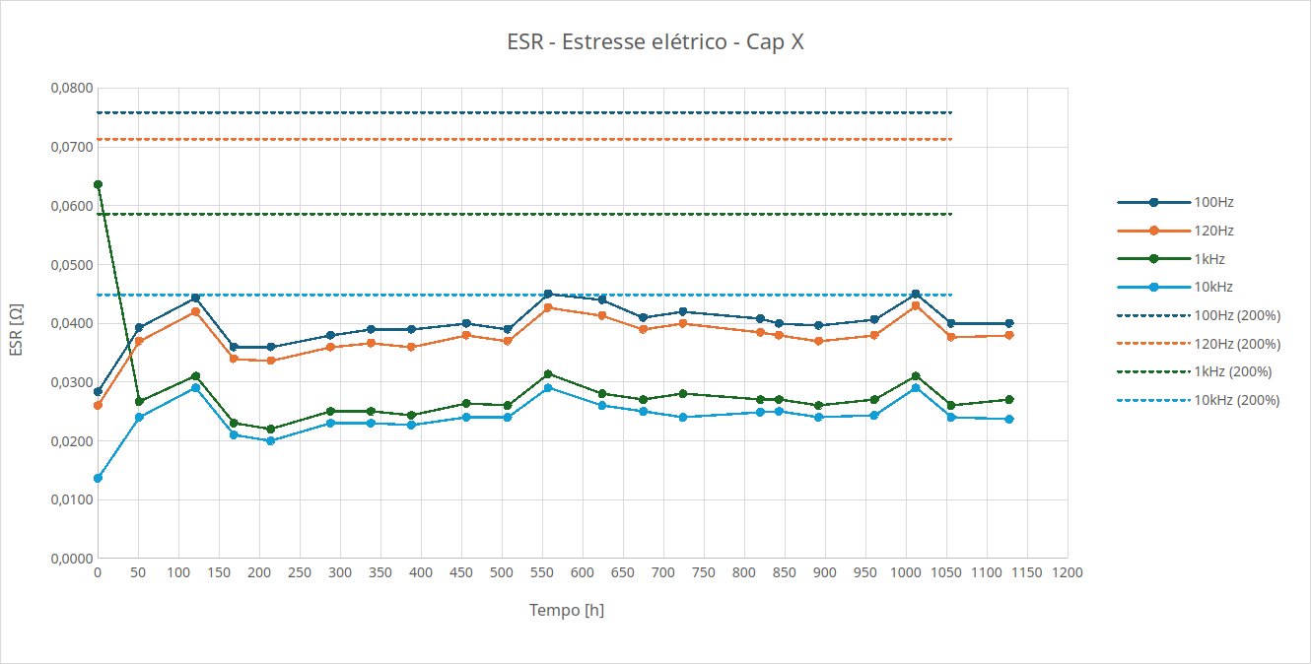
Accelerated testing: preliminary results (electrical)

Slide 19
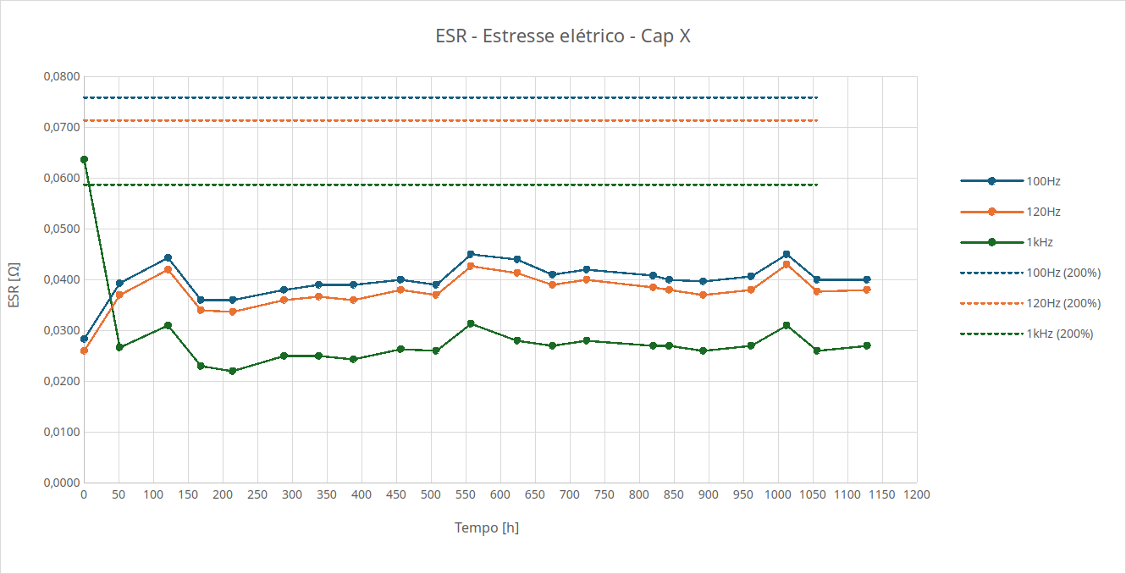
Accelerated testing: preliminary results (electrical)

Slide 20
Variable capacitance test: methods
Neste slide, descrição bem breve da jiga, da bancada, e do planejamento dos testes com a capacitância
Descrever também quais features vão ser avaliadas inicialmente

Slide 21
Variable capacitance test: preliminary results
Aqui observações e análises sobre os resultados no tempo
AQUI ALGUNS GRÁFICOS NO TEMPO

Slide 22
Variable capacitance test: preliminary results
Aqui observações e análises sobre a correlação
AQUI CORRELAÇÃO DE FEATURES

Slide 23
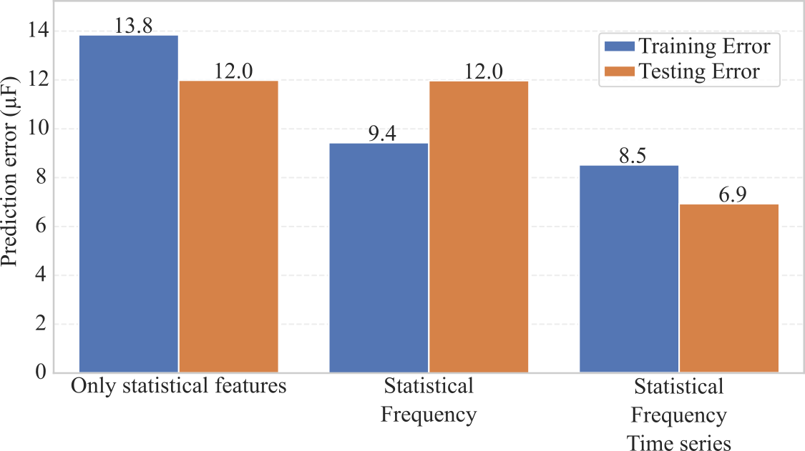
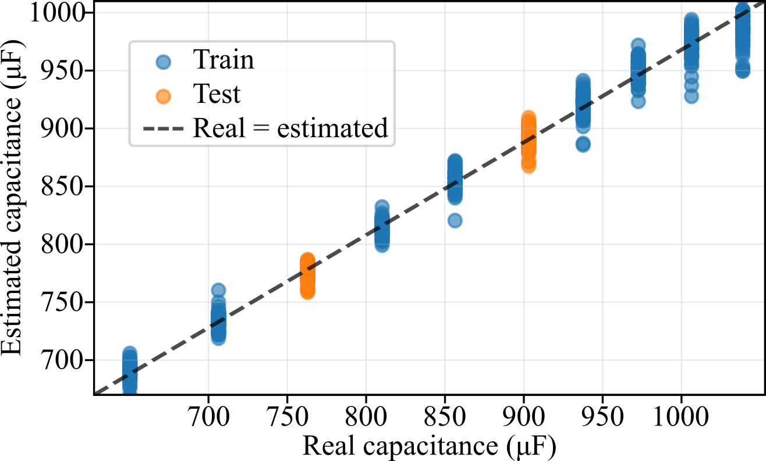
Preliminary results and challenges
Machine learning tools
Results:
More than 20 models evaluated using external DAQ
Three lines of research:
  Only statistical features (RMS, peak to peak, etc.)
  Statistical + frequency analysis
  Statistical + frequency + time series data
Best results obtained using feedforward neural networks (approx. 1% mean error), but high uncertainty
Unknown whether the results extrapolate to different scenarios (series resistance, grid impedance, etc.)
Can detect if a capacitor has degraded, but can’t predict remaining useful life yet
Possible solutions:
Improve ML models and experimental jig
Use simulations to expand dataset and evaluate different parameters
Measure capacitance during endurance tests and develop a jig with aged capacitors to estimate remaining useful life

Slide 24
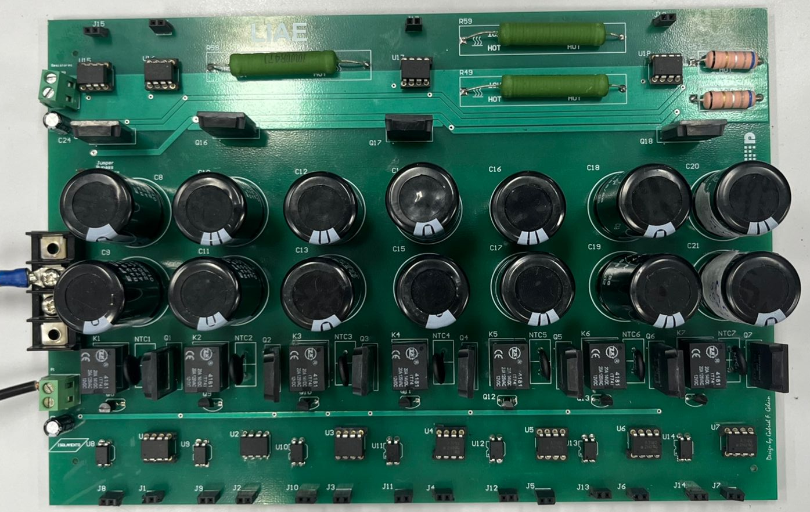
Project timeline - future activities
Team:
LIAE: 2 senior researchers
2 undergraduates
Nidec: ?
Faster embedded acquisition
Wider range of test conditions
Simulation models to evaluate influence of external factors which are hard to replicate
Aged capacitor jig to evaluate real capacitors and correlate capacitance and remaining useful life
Controlled resistance
Wider capacitance range
Improved capacitance measurement
Adapt model for embedding
Modify firmware
High-fidelity simulation model development
11/2025
03/2026
06/2026
10/2026
01/2027
Improved test jig design
Improved experimental tests
Solution development
Model embedding
Final validation
ML model development
Online evaluation
Improve model with simulation and experimental data
Validate model in endurance tests
AQUI FOTO DA NOVA JIGA
Aged capacitor jig

Slide 25
Thank you

